Slide 1
Principles of Data Science
Li Niu

Slide 2
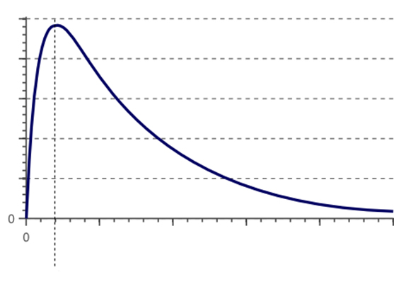
Curse of dimensionality
With fixed number of training samples, high dimension can easily cause overfitting.
Classifier performance
underfitting
overfitting
Feature dimension

Slide 3
Problem of low-dimension
However, low dimension may cause underfitting.
Classifier performance
underfitting
overfitting
Feature dimension

Slide 4
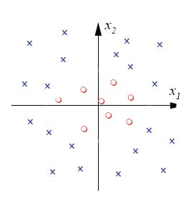
Problem of low-dimension
There is no linear classifier that can separate positive from negative

Slide 5
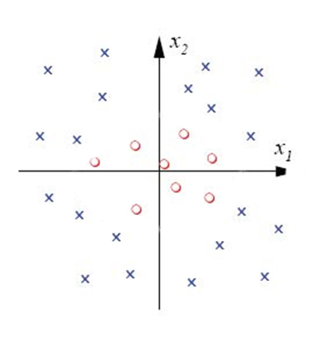
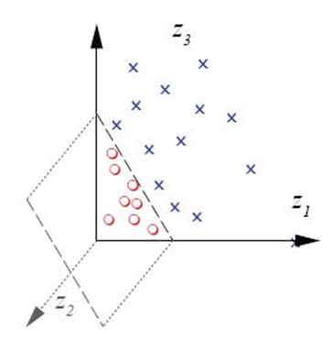
Kernel trick
Elevate low dimension to high dimension to make non-separable data separable

Slide 6
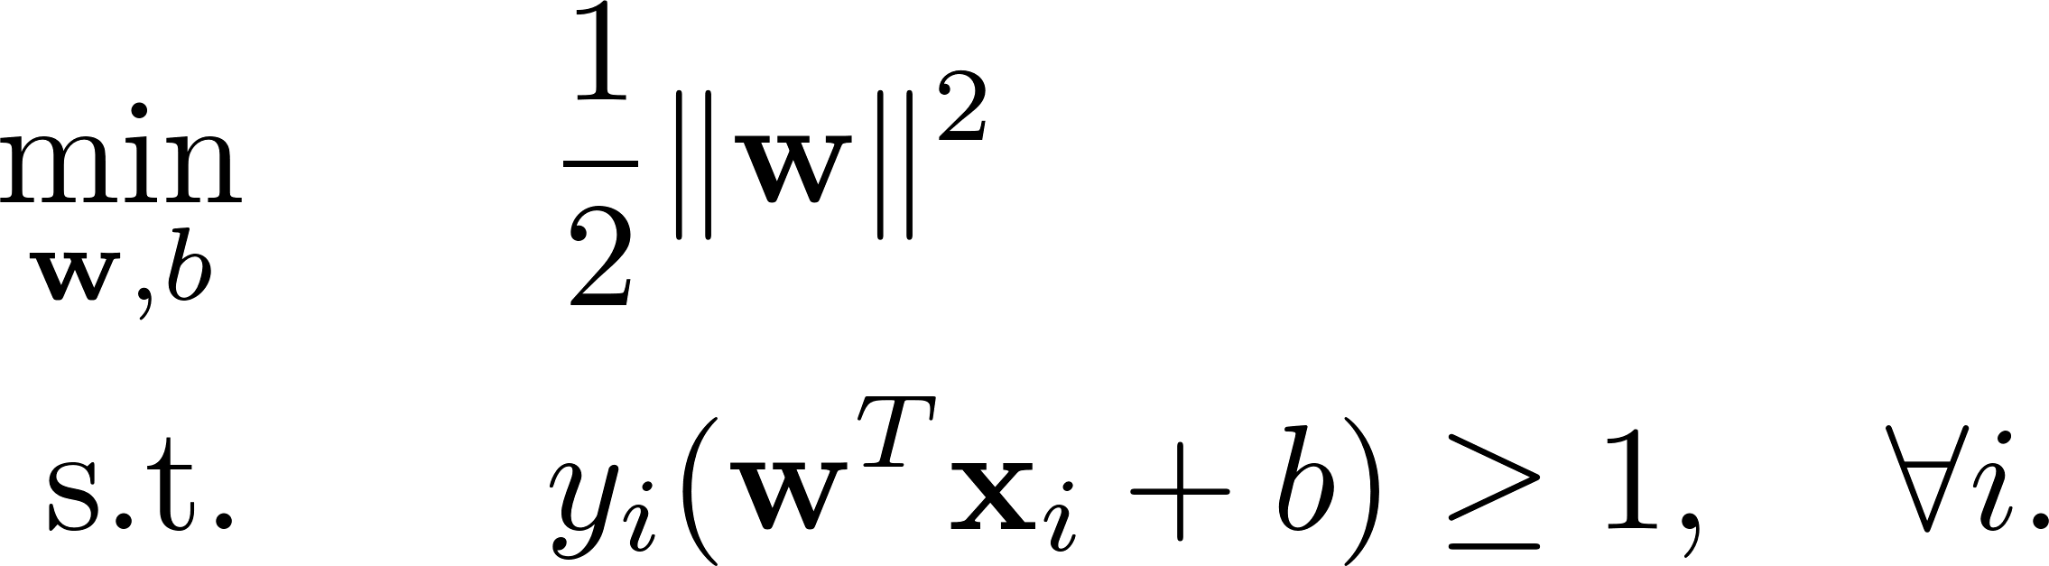
Example: kernel SVM
Primal form of SVM:
hard margin

Slide 7
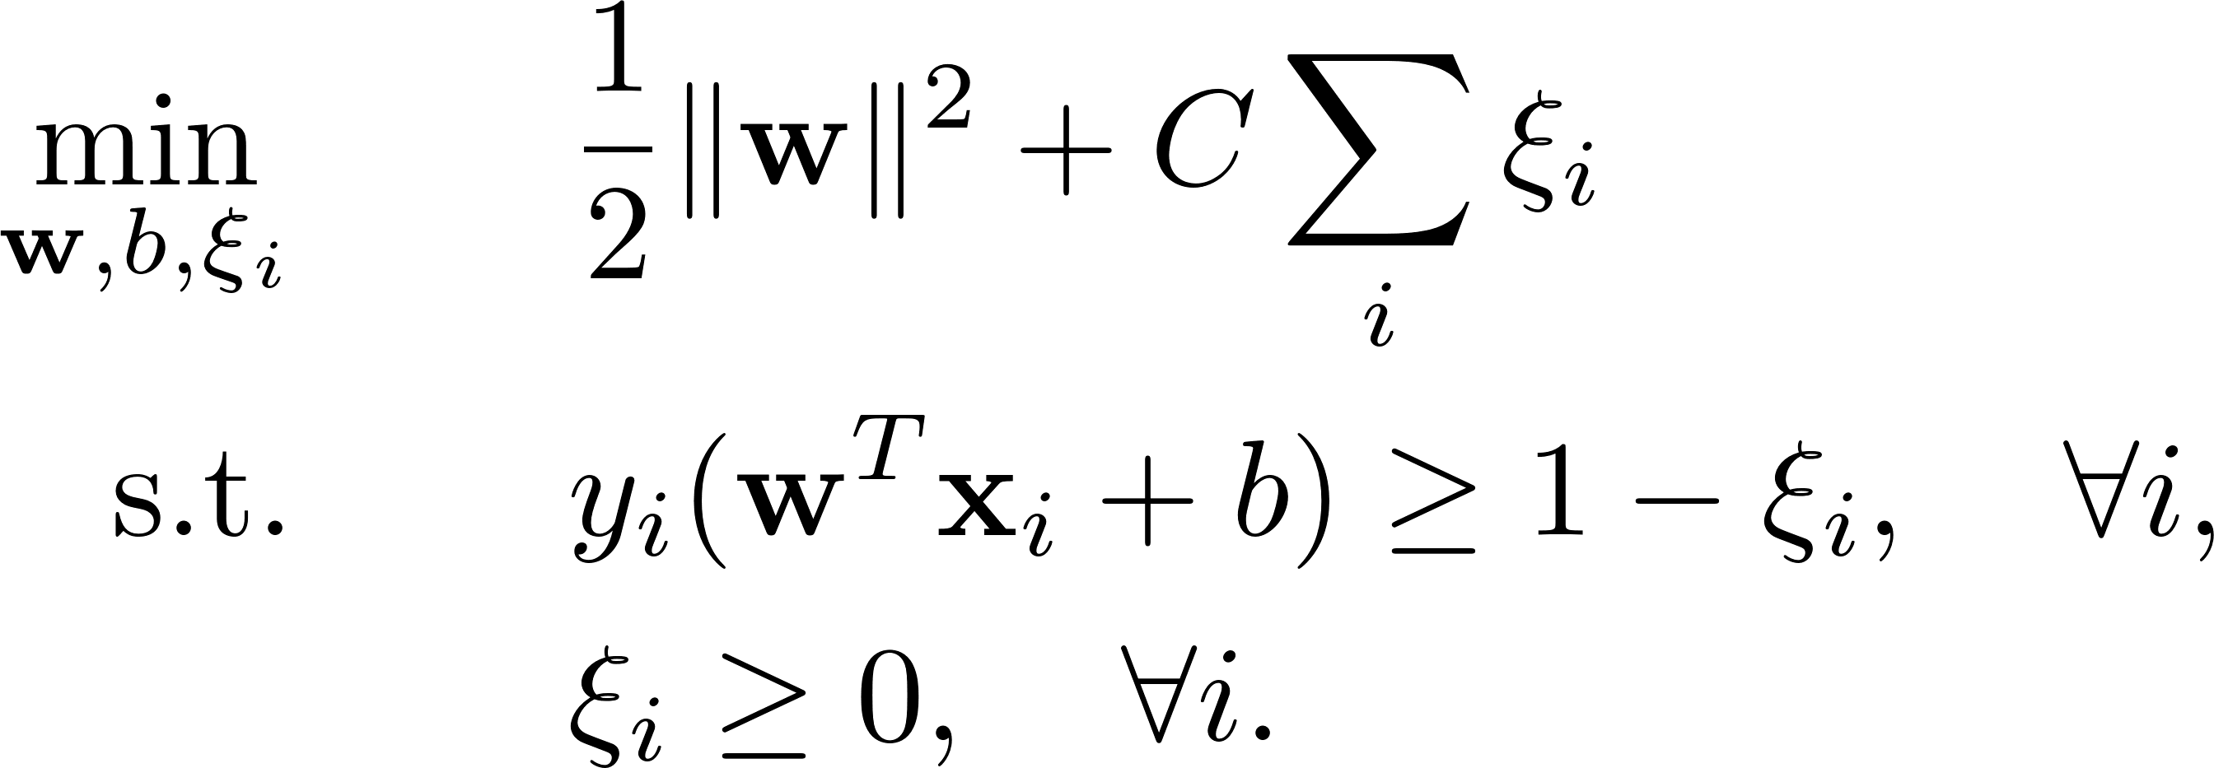
Example: kernel SVM
Primal form of SVM:
hard margin
soft margin

Slide 8
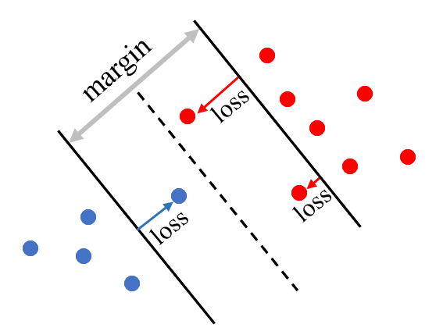
Example: kernel SVM
Primal form of SVM:
positive samples
negative samples

Slide 9
Example: kernel SVM
Primal form of SVM:
There is no hyperplane that can separate positive samples from negative samples.

Slide 10
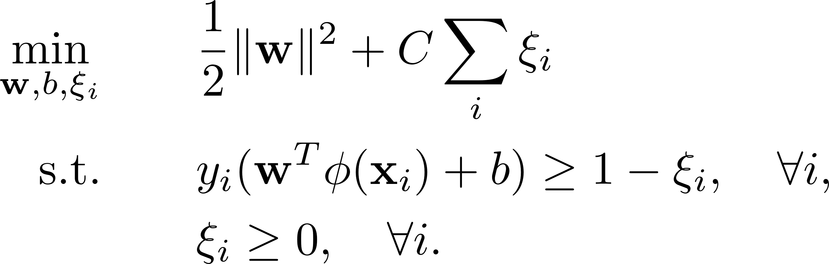
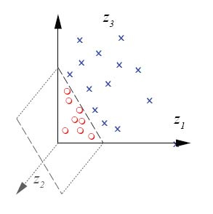
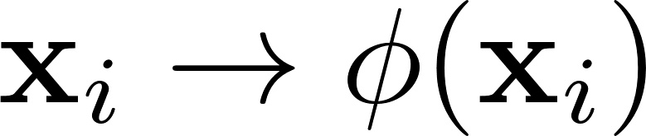
Example: kernel SVM
Primal form of SVM:
Lift to higher dimension so that a hyperplane can separate positive samples from negative samples.

Slide 11
Example: kernel SVM
Elevate to finite dimension:
0-order term
1-order terms
2-order terms

Slide 12
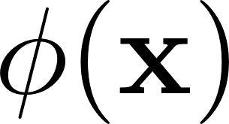
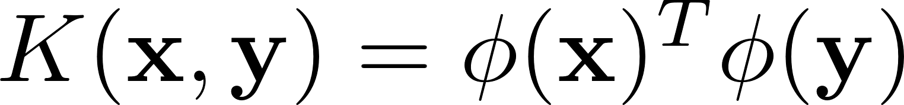
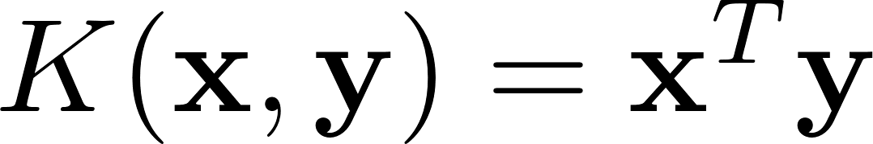
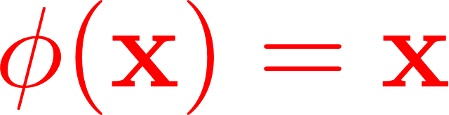
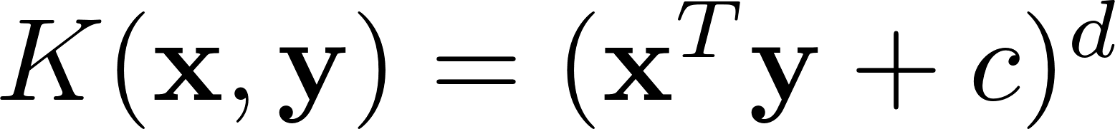
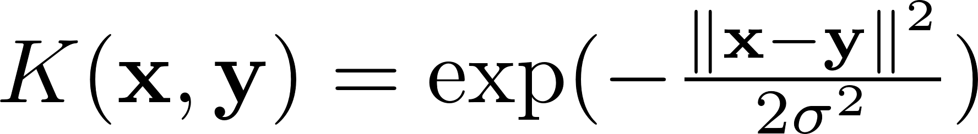
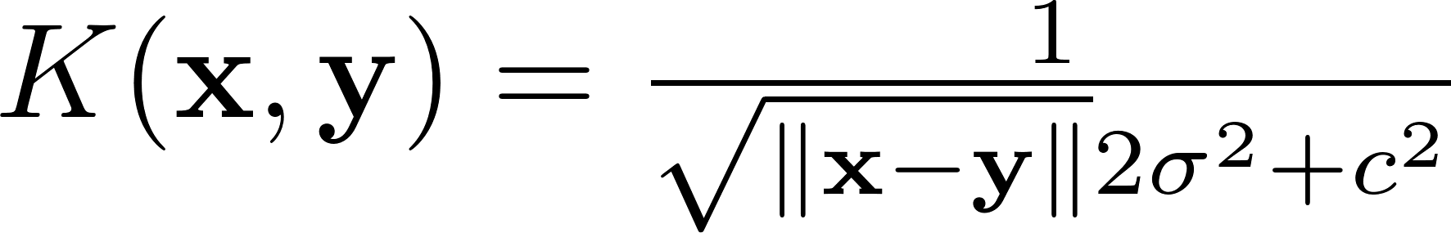
Example: kernel SVM
Elevate to infinite dimension:
No explicit form for
Instead, we compute kernel
Linear kernel:
identity mapping
Polynomial kernel:
Gaussian kernel: Radial Basis Function (RBF)
Sigmoid kernel:
Inverse multi-quadratic kernel:
….

Slide 13
Example: kernel SVM
Primal form of SVM:
Lagrangian form:

Slide 14
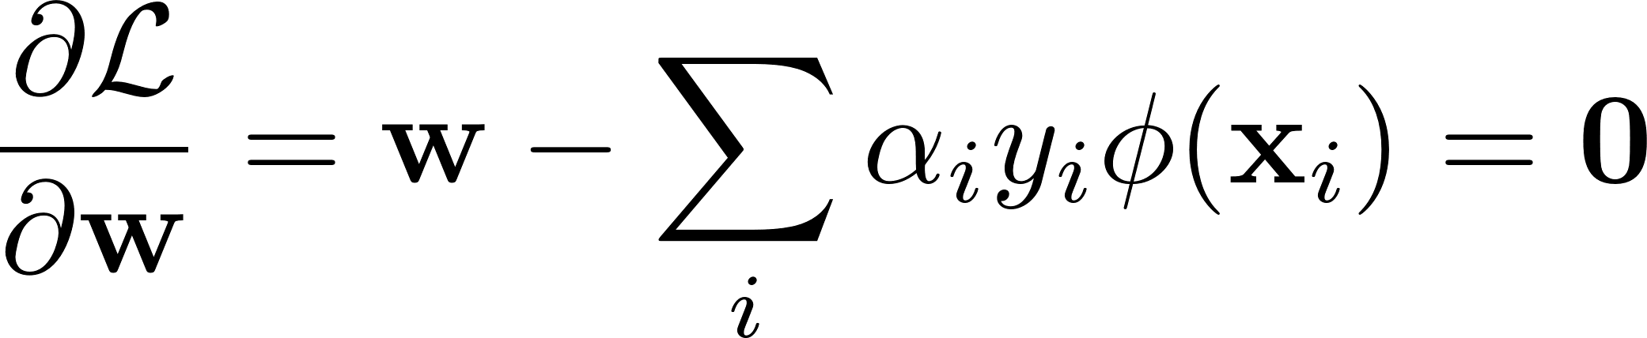
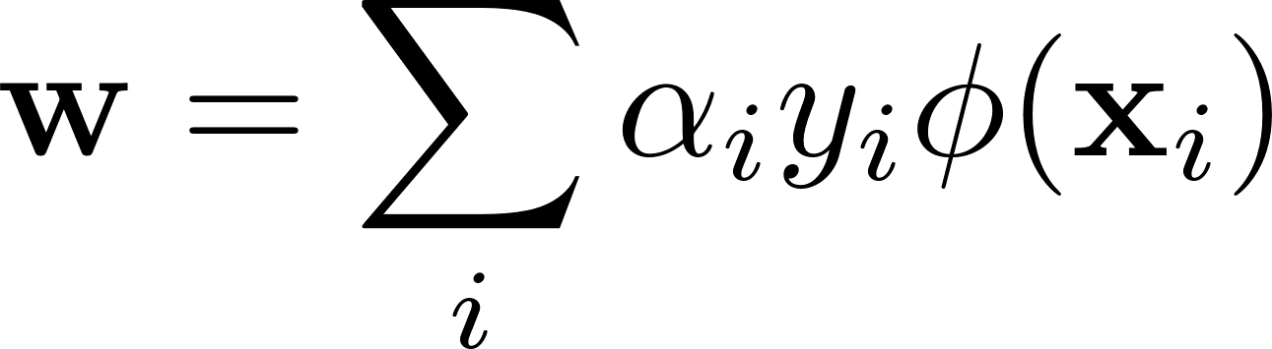
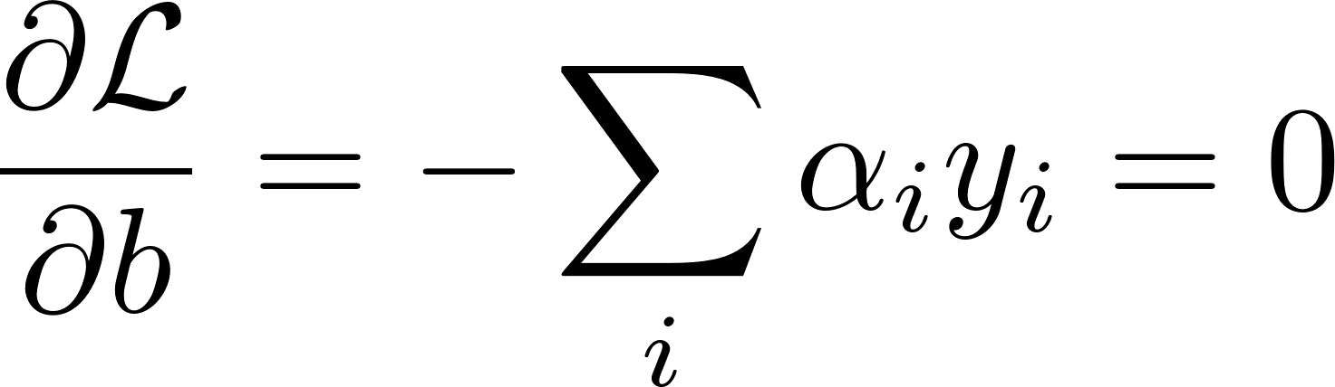
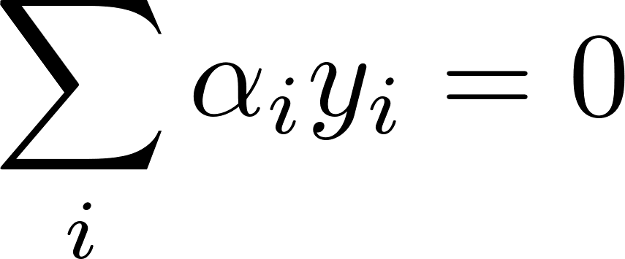
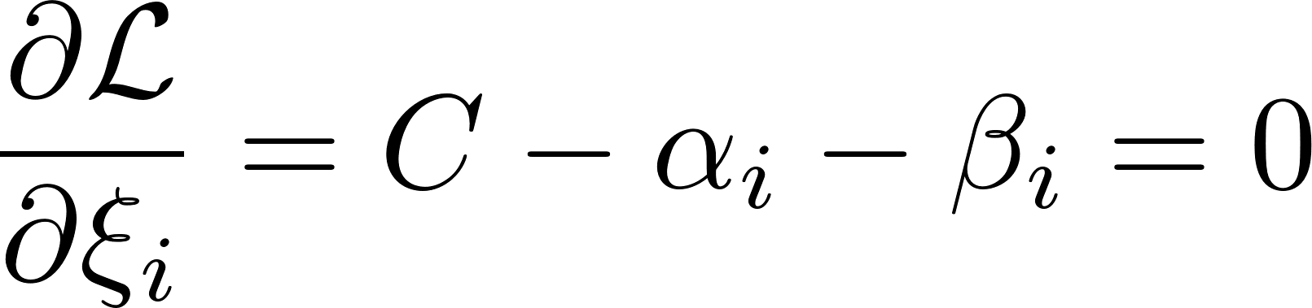
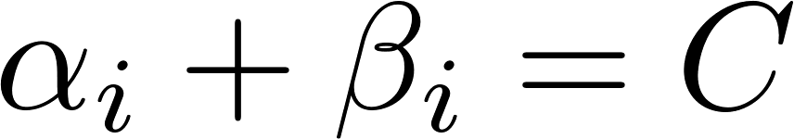
Example: kernel SVM
Lagrangian form:

Slide 15
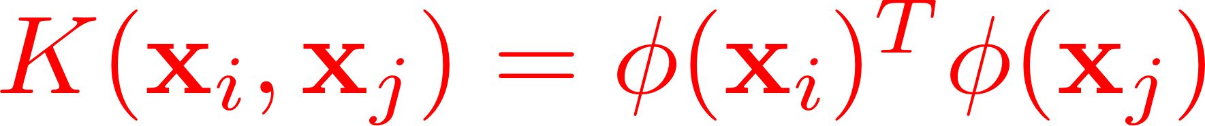
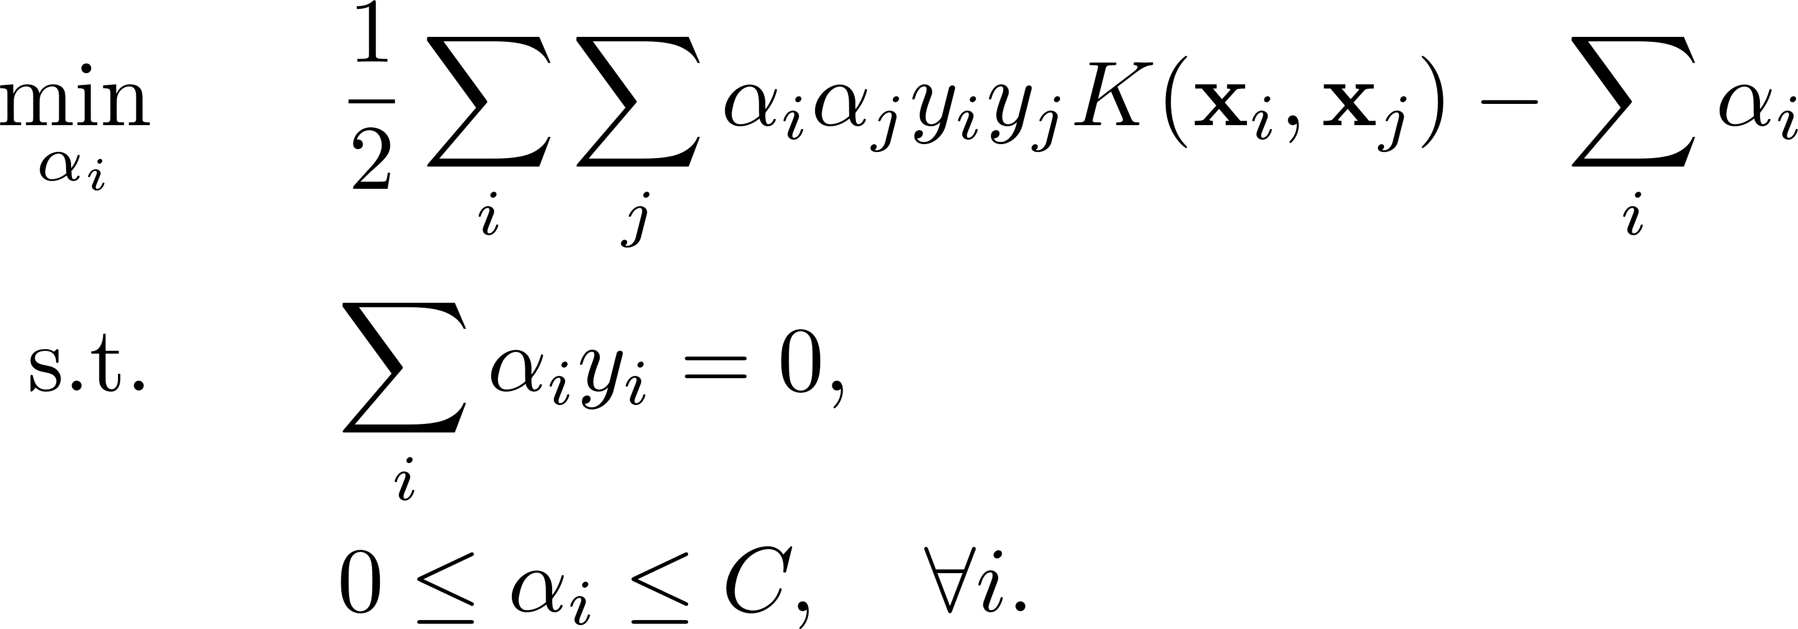
Example: kernel SVM
Lagrangian form:
Dual form of SVM:

Slide 16
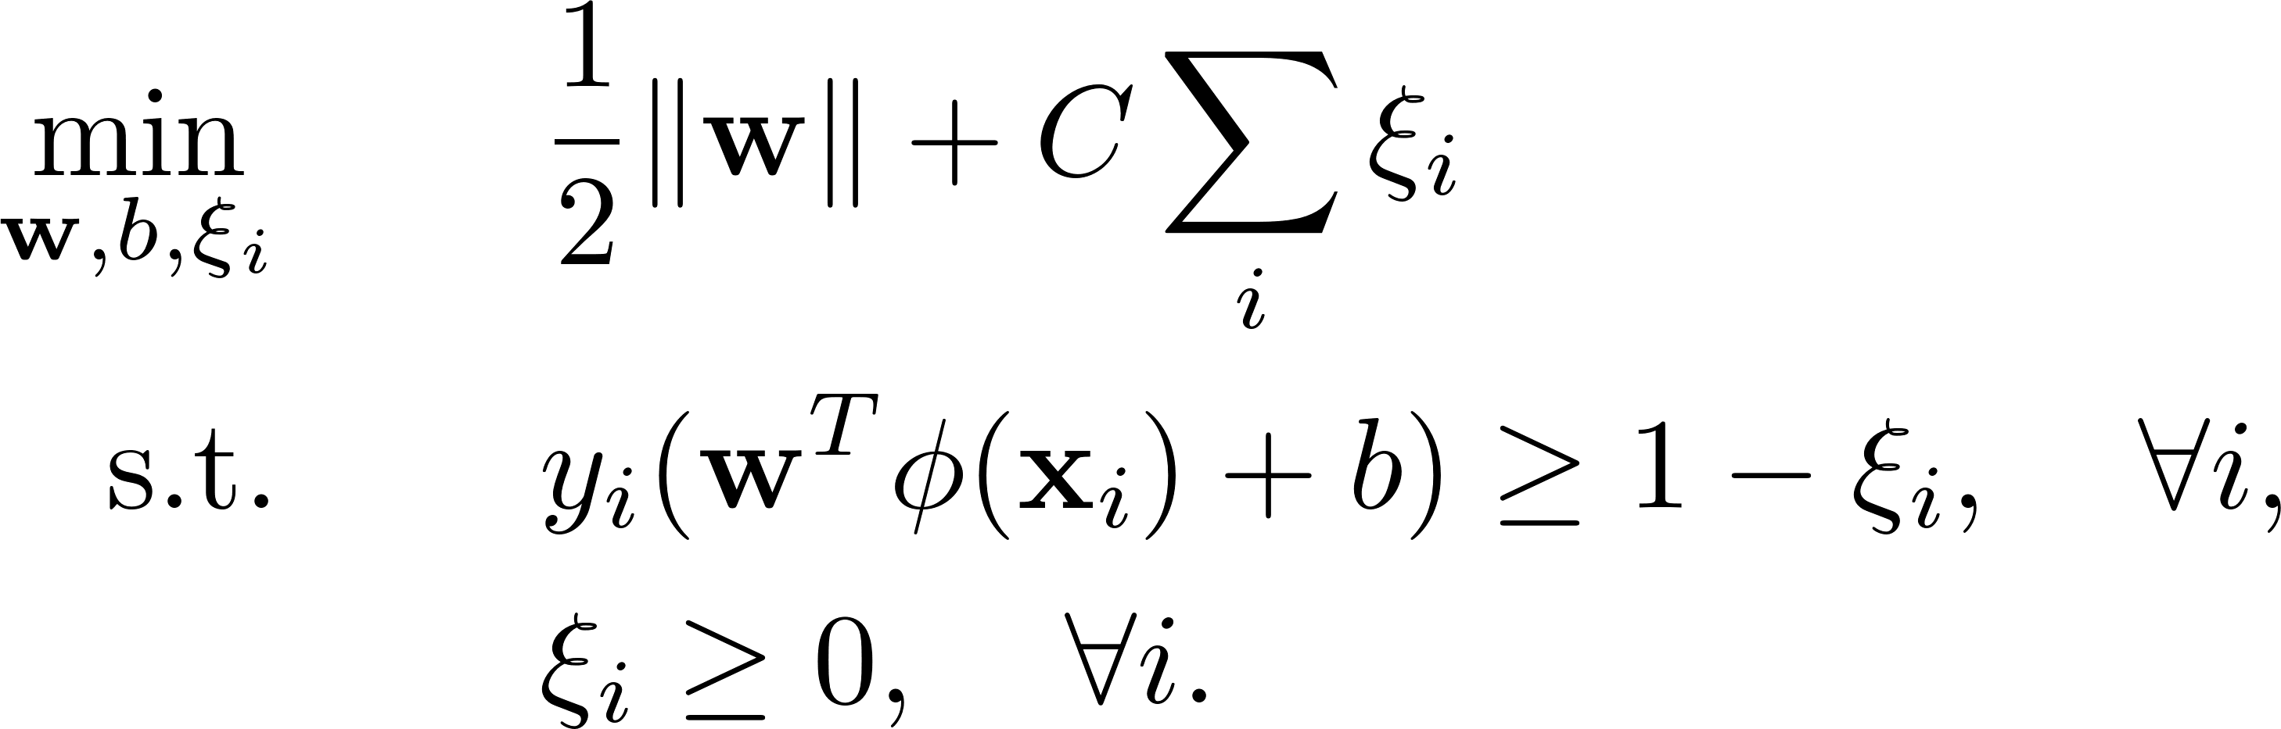
Example: kernel SVM
Primal form of SVM:
Dual form of SVM:
kernel trick

Slide 17
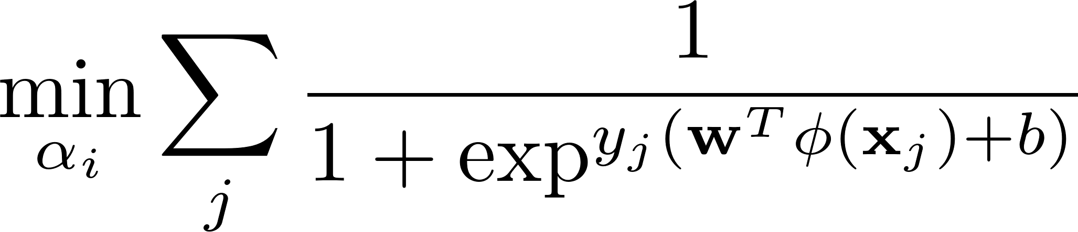
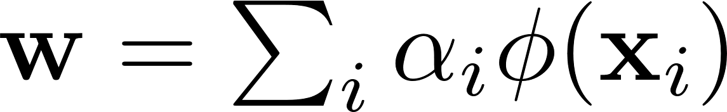
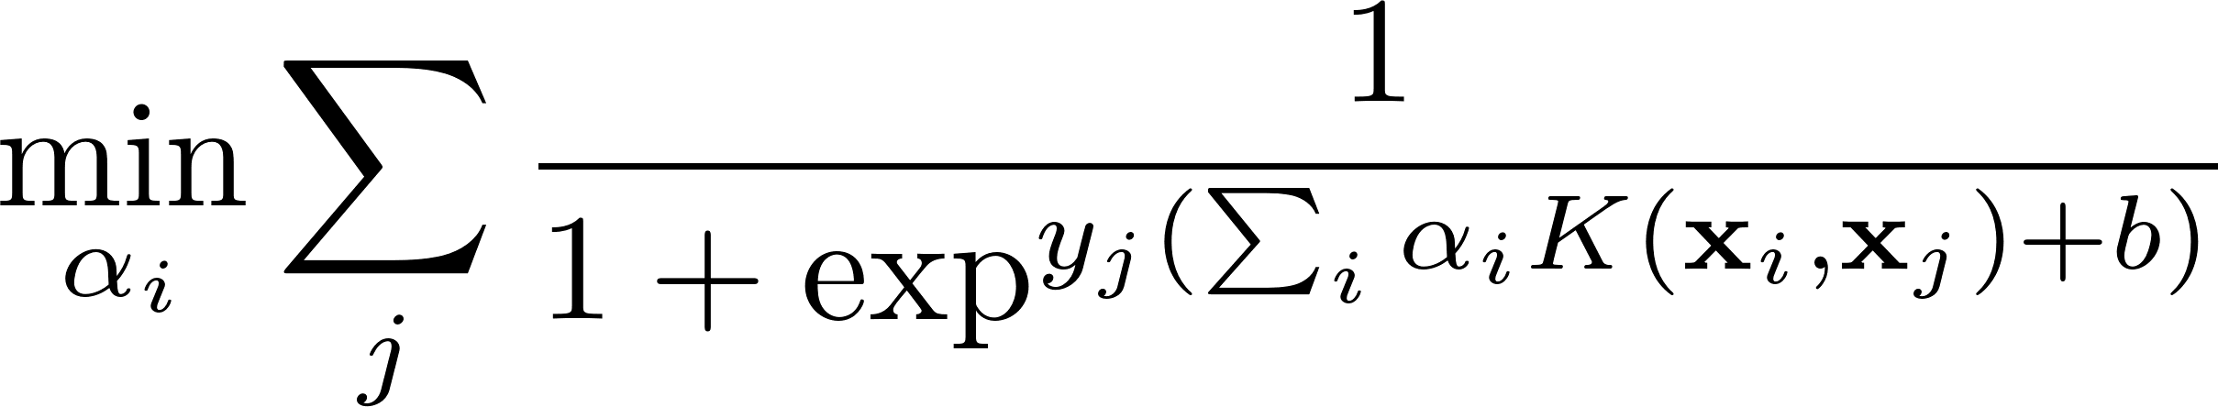
Kernel trick for other machine learning models
Before deep learning, kernel trick is very popular in traditional machine learning.
kernel trick
Kernel in SVM:
Kernel in logistic regression:
representation theorem:

Slide 18
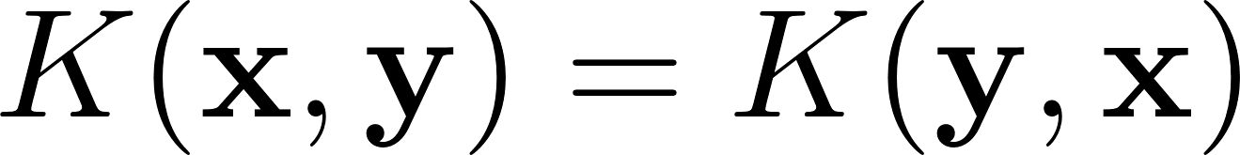
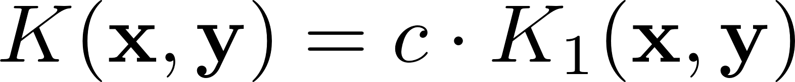
Kernel properties
Symmetry
Cauchy-Schwarz Inequality
Closure property

Slide 19
Thanks!

